Slide 1

CS-411: Network Security
Lecture # 20: Security Problems in Network Protocols and Defense Mechanisms
Prof. Dr. Sufian Hameed
Department of Computer Science
FAST-NUCES

Slide 2
Overview
How the Internet works and some basic vulnerabilities
Network protocol security
IPSEC
BGP instability
DNS rebinding and DNSSEC
Standard network defenses
Firewall
Packet filter (stateless, stateful), Application layer proxies
Traffic shaping
Intrusion detection
Anomaly and misuse detection

Slide 3
Internet Infrastructure
Backbone
ISP
ISP
Local and interdomain routing
TCP/IP for routing and messaging
BGP for routing announcements
Domain Name System
Find IP address from symbolic name (www.khi.nu.edu.pk)
Notes:
An Internet service provider ISP is provided with a unique URL access address. This address is a unique number. The number for each ISP is stored within a DNS server. The DNS servers interpret the ISP URL Domain name and provide the appropriate IP address number. The Domain is under the control of a specialised computer, called a PDC, (primary domain controller).^{[2]} This computer holds records of all the user accounts within the domain, their rights to access information, and lists of approved System Operatives. This PDC is backed up by a SDC, (a secondary domain controller), this computer synchronises itself with the PDC and takes over the role in the event of a PDC failure.^{[3]} Multiple replication servers connect to these control computers and they are routed to the Internet backbone to provide the requested data to and from the domain.
Border Gateway Protocol (BGP) is the protocol which is used to make core routing decisions on the Internet; it involves a table of IP networks or "prefixes" which designate network reachability among autonomous systems (AS). BGP is a path vector protocol or a variant of a Distance-vector routing protocol. BGP does not involve traditional Interior Gateway Protocol (IGP) metrics, but routing decisions are made based on path, network policies and/or rule-sets. For this reason, it is more appropriately termed a reachability protocol rather than routing protocol.

Slide 4
TCP Protocol Stack
Application protocol
Application
Application
Transport
TCP protocol
Transport
Network
IP protocol
IP
IP protocol
Network
Link
Data Link
Network Access
Data Link
Link
Notes:
Application, Presentation and Session = Application
Transport = Transport
Network = Internet
Data Link, Physical = Network Interface

Slide 5
Data Formats
TCP Header
Application
Application message - data
message
Transport (TCP, UDP)
segment
TCP
data
TCP
data
TCP
data
Network (IP)
packet
IP
TCP
data
Link Layer
frame
ETH
IP
TCP
data
ETF
IP Header
Link (Ethernet)
Header
Link (Ethernet)
Trailer

Slide 6
Internet Protocol
Connectionless
Unreliable
No central monitoring or performance measurement facility exists that tracks or maintains the state of the network
Best effort
Users get unspecified variable bit rate and delivery time, depending on the current traffic load
Notes:
src and dest ports not parts of IP hdr
Version
Header Length
Type of Service
Total Length
Identification
Flags
Fragment Offset
Time to Live
Protocol
Header Checksum
Source Address of Originating Host
Destination Address of Target Host
Options
Padding
IP Data
Notes:
Unreliable =
Internet Protocol uses the end-to-end principle in its design. Under this design, the network infrastructure is assumed to be inherently unreliable at any single network element or transmission medium and assumed to be dynamic in terms of availability of links and nodes. No central monitoring or performance measurement facility exists that tracks or maintains the state of the network.
Best Effort
Best-effort delivery describes a network service in which the network does not provide any guarantees that data is delivered or that a user is given a guaranteed quality of service level or a certain priority.
In a best-effort network all users obtain best-effort service, meaning that they obtain unspecified variable bit rate and delivery time, depending on the current traffic load.
src and dest ports not parts of IP hdr (what does this means)
The transport layer contains a destination port number and a source port number in the header
This port number is used in the transport layer header to indicate to which application that piece of data is associated.

Slide 7
IP Routing
alice
Office gateway
Packet
Source
121.42.33.12
bob
121.42.33.12
Destination
132.14.11.51
132.14.11.1
ISP
132.14.11.51
121.42.33.1
Typical route uses several hops
IP: no ordering or delivery guarantees

Slide 8
IP Protocol Functions (Summary)
Routing
IP host knows location of router (gateway)
IP gateway must know route to other networks
Fragmentation and reassembly
If max-packet-size less than the user-data-size
Error reporting
ICMP packet to source if packet is dropped
TTL field: decremented after every hop
Packet dropped f TTL=0. Prevents infinite loops.

Slide 9
Problem: no src IP authentication
Client is trusted to embed correct source IP
Easy to override using raw sockets
a raw socket is an internet socket that allows direct sending and receiving of Internet Protocol packets without any protocol-specific transport layer formatting.
Libnet: a library for formatting raw packets with arbitrary IP headers
Anyone who owns their machine can send packets with arbitrary source IP
… response will be sent back to forged source IP
Implications:
Anonymous DoS attacks;
Anonymous infection attacks (e.g. slammer worm)
Notes:
In computer networking, a raw socket is an internet socket that allows direct sending and receiving of Internet Protocol packets without any protocol-specific transport layer formatting.
In standard sockets, the payload to be transmitted is encapsulated according to the chosen transport layer protocol (e.g. TCP, UDP). In contrast, raw sockets usually receive raw packets including the header. When transmitting packets, the automatic addition of a header may be a configurable option of the socket.

Slide 10
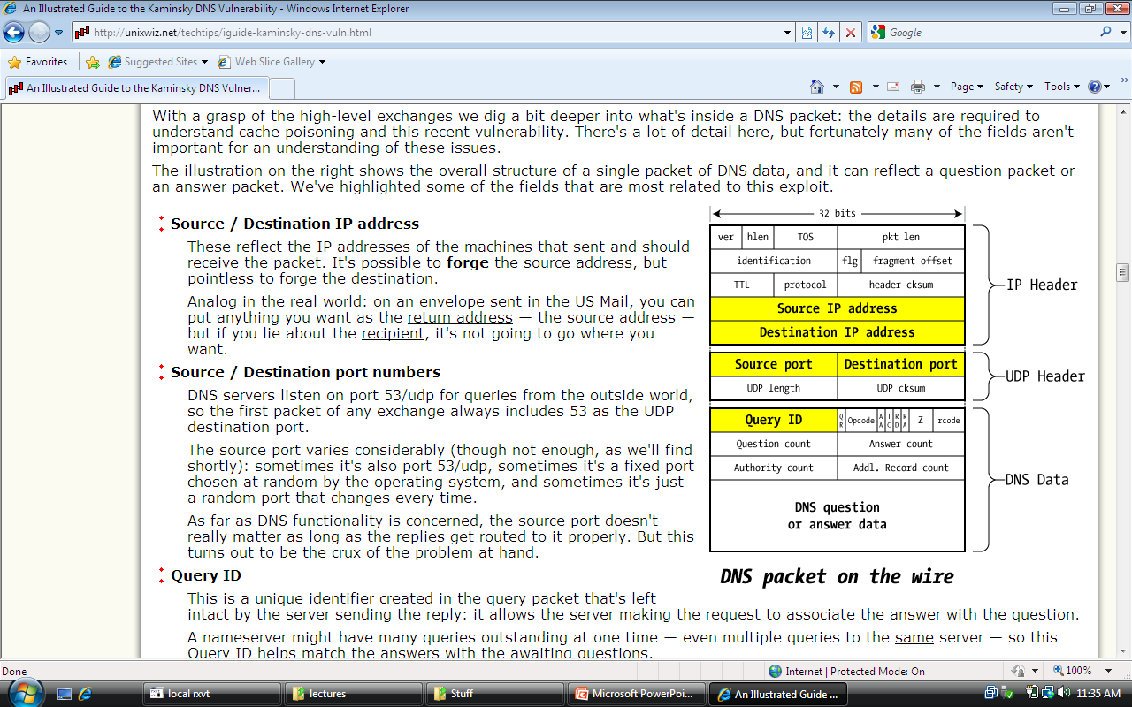
User Datagram Protocol (UDP)
Unreliable transport on top of IP:
No acknowledgment
No congestion control
No message continuation

Slide 11
Transmission Control Protocol (TCP)
Connection-oriented, preserves order
Sender
Break data into packets
Attach packet numbers
Receiver
Acknowledge receipt; lost packets are resent
Reassemble packets in correct order
Book
Mail each page
Reassemble book
1
19
1
5
1

Slide 12
TCP Header
Source Port
Dest port
SEQ Number
ACK Number
U
R
G
A
C
K
P
S
H
P
S
R
S
Y
N
F
I
N
TCP Header
Other stuff
Notes:
URG (1 bit) – indicates that the Urgent pointer field is significant
ACK (1 bit) – indicates that the Acknowledgment field is significant. All packets after the initial SYN packet sent by the client should have this flag set.
PSH (1 bit) – Push function. Asks to push the buffered data to the receiving application.
RST (1 bit) – Reset the connection
SYN (1 bit) – Synchronize sequence numbers. Only the first packet sent from each end should have this flag set. Some other flags change meaning based on this flag, and some are only valid for when it is set, and others when it is clear.
FIN (1 bit) – No more data from sender

Slide 13
Review: TCP Handshake
C
S
SYN:
SN_{C}←rand_{C}
Listening
SN_{S}←rand_{S}
AN_{S}←SN_{C}+ 1
Store SN_{C} , SN_{S}
SYN/ACK:
Wait
SN←SN_{C}+1
AN←SN_{S}+ 1
ACK:
Established
Received packets with SN too far out of window are dropped
Notes:
SYN: The active open is performed by the client sending a SYN to the server. The client sets the segment's sequence number to a random value A.
SYN-ACK: In response, the server replies with a SYN-ACK. The acknowledgment number is set to one more than the received sequence number (A + 1), and the sequence number that the server chooses for the packet is another random number, B.
ACK: Finally, the client sends an ACK back to the server. The sequence number is set to the received acknowledgement value i.e. A + 1, and the acknowledgement number is set to one more than the received sequence number i.e. B + 1.
At this point, both the client and server have received an acknowledgment of the connection. The steps 1, 2 establish the connection parameter (sequence number) for one direction and it is acknowledged. The steps 2, 3 establish the connection parameter (sequence number) for the other direction and it is acknowledged. With these, a full-duplex communication is established.

Slide 14
Basic Security Problems
1. Network packets pass by untrusted hosts
Eavesdropping, packet sniffing
Especially easy when attacker controls a machine close to victim
2. TCP state can be easy to guess
Enables spoofing and session hijacking
3. Denial of Service (DoS) vulnerabilities
DDoS lecture

Slide 15
1. Packet Sniffing
Promiscuous NIC reads all packets
Read all unencrypted data (e.g., “wireshark”)
ftp, telnet (and POP, IMAP) may send passwords in clear
Eve
Network
Alice
Bob
Prevention: Encryption (next lecture: IPSEC)
In promiscuous mode the network interface controller (NIC) causes the controller to pass all traffic it receives to the central processing unit (CPU) rather than passing only the frames that the controller is intended to receive.
Notes:
In computer networking, promiscuous mode or promisc mode is a mode for a wired network interface controller (NIC) or wireless network interface controller (WNIC) that causes the controller to pass all traffic it receives to the central processing unit (CPU) rather than passing only the frames that the controller is intended to receive.

Slide 16
2. TCP Connection Spoofing
Why random initial sequence numbers? (SN_{C} , SN_{S} )
Suppose init. sequence numbers are predictable
Attacker can create TCP session on behalf of forged source IP
Breaks IP-based authentication (e.g. SPF, /etc/hosts )
TCP SYN
Server
attacker
srcIP=victim
Victim
SYN/ACK dstIP=victim
SN=server SN_{S}
ACK
srcIP=victim
AN=predicted SN_{S}
server thinks command is from victim IP addr
command
Notes:
Example commands: send spam email on behalf of victim IP address

Slide 17
3. DoS vulnerability [Watson’04]
Suppose attacker can guess seq. number for an existing connection:
Attacker can send Reset packet to close connection. Results in DoS.
Naively, success prob. is 1/2³² (32-bit seq. #’s).
Most systems allow for a large window of acceptable seq. #’s
Much higher success probability.
Attack is most effective against long lived connections, e.g. BGP

Slide 18
Random initial TCP SNs
Unpredictable SNs prevent basic packet injection
… but attacker can inject packets after eavesdropping to obtain current SN
Most TCP stacks now generate random SNs
Random generator should be unpredictable
GPR’06: Linux RNG for generating SNs is predictable
Attacker repeatedly connects to server
Obtains sequence of SNs
Can predict next SN
Attacker can now do TCP spoofing (create TCP session with forged source IP)

Slide 19
Routing Vulnerabilities

Slide 20
Routing Vulnerabilities
Routing protocols:
ARP (addr resolution protocol): IP addr ⟶ eth addr
Node A can confuse gateway into sending it traffic for B (ARP Spoofing --- Because ARP does not provide methods for authenticating ARP replies on a network)
By proxying traffic, attacker A can easily inject packets into B’s session (e.g. WiFi networks)
OSPF: used for routing within an AS
BGP: routing between ASs
Attacker can cause entire Internet to send traffic for a victim IP to attacker’s address.
AS will advertise to its provider(s) and/or peer(s) that it can deliver any traffic destined for some other host/AS
Example: Youtube mishap (see DDoS lecture)
Notes:
OSPF: open shortest path first. Open Shortest Path First (OSPF) is a link-state routing protocol for Internet Protocol (IP) networks. It uses a link state routing algorithm and falls into the group of interior routing protocols, operating within a single autonomous system (AS).
ARP : Because ARP does not provide methods for authenticating ARP replies on a network, ARP replies can come from systems other than the one with the required Layer 2 address. An ARP proxy is a system which answers the ARP request on behalf of another system for which it will forward traffic, normally as a part of the network's design, such as for a dialup internet service. By contrast, in ARP spoofing the answering system, or spoofer, replies to a request for another system's address with the aim of intercepting data bound for that system. A malicious user may use ARP spoofing to perform a man-in-the-middle or denial-of-service attack on other users on the network. Various software exists to both detect and perform ARP spoofing attacks, though ARP itself does not provide any methods of protection from such attacks.
ARP spoofing^{[1]} is a technique whereby an attacker sends fake ("spoofed") Address Resolution Protocol (ARP) messages onto a Local Area Network. Generally, the aim is to associate the attacker's MAC address with the IP address of another host (such as the default gateway), causing any traffic meant for that IP address to be sent to the attacker instead.
Proxy ARP (Address Resolution Protocol) is a technique by which a device on a given network answers the ARP queries for a network address that is not on that network. The ARP Proxy is aware of the location of the traffic's destination, and offers its own MAC address in reply, effectively saying, "send it to me, and I'll get it to where it needs to go." Serving as an ARP Proxy for another host effectively directs LAN traffic to the Proxy. The "captured" traffic is then typically routed by the Proxy to the intended destination via another interface or via a tunnel.
IP hijacking (sometimes referred to as BGP hijacking, prefix hijacking or route hijacking) is the illegitimate takeover of groups of IP addresses by corrupting Internet routing tables.
Each AS uses BGP to advertise prefixes that it can deliver traffic to. For example if the network prefix 192.0.2.0/24 is inside AS 64496, then that AS will advertise to its provider(s) and/or peer(s) that it can deliver any traffic destined for 192.0.2.0/24.
IP hijacking can occur deliberately or by accident in one of several ways:
An AS announces that it originates a prefix that it does not actually originate.
An AS announces a more specific prefix than what may be announced by the true originating AS.
An AS announces that it can route traffic to the hijacked AS through a shorter route than is already available, regardless of whether or not the route actually exists.

Slide 21
Interdomain Routing
earthlink.net
Stanford.edu
BGP
Autonomous System
OSPF
connected group of one or more Internet Protocol prefixes under a single routing policy (aka domain)
Notes:
OSPF: open shortest path first

Slide 22
BGP example [D. Wetherall]
1
3
3 2 7
4
2 7
2 6 5
2 6 5
3 2 6 5
5
8
2
2 7
6 5
7 2 6 5
7
2 7
7
6 2 7
5
2 6 5
6
7
5
Transit: 2 provides transit for 7
Algorithm seems to work OK in practice
… but BGP does not respond well to frequent node outages

Slide 23
Security Issues
BGP packets are un-authenticated
Attacker can inject advertisements for arbitrary routes
Advertisement will propagate everywhere
Used for DoS and spam
detailed example in DDoS lecture
Human error problems:
Mistakes quickly propagate to the entire Internet

Slide 24
OSPF: routing inside an AS
Link State Advertisements (LSA):
Flooded throughout AS so that all routers in the AS have a complete view of the AS topology
Transmission: IP datagrams, protocol = 89
Neighbor discovery:
Routers dynamically discover direct neighbors on attached links --- sets up an “adjacently”
Once setup, they exchange their LSA databases
Notes:
A distance-vector routing protocol requires that a router informs its neighbours of topology changes periodically. Compared to link-state protocols, which require a router to inform all the nodes in a network of topology changes, distance-vector routing protocols have less computational complexity and message overhead.
The link-state protocol is performed by every switching node in the network (i.e. nodes that are prepared to forward packets; in the Internet, these are called routers). The basic concept of link-state routing is that every node constructs a map of the connectivity to the network, in the form of a graph, showing which nodes are connected to which other nodes. Each node then independently calculates the next best logical path from it to every possible destination in the network. The collection of best paths will then form the node's routing table.
This contrasts with distance-vector routing protocols, which work by having each node share its routing table with its neighbors. In a link-state protocol the only information passed between nodes is connectivity related.
Link-state algorithms are sometimes characterized informally as each router 'telling the world about its neighbors'.

Slide 25




Example: LSA from Ra and Rb
Ra LSA
Net-1
Rb LSA
Ra
Rb
R3
LSA DB:
Net-1
Net-1
Ra
Ra
Rb
Rb
2
2
3
1
3
Notes:
Ra and Rb send an LSA about the connection between them. That LSA is received by R3 and it updates its own LSA database.

Slide 26
Security features
OSPF message integrity (unlike BGP)
Every link can have its own shared secret
Unfortunately, OSPF uses an insecure MAC:
MAC(k,m) = MD5(data ll key ll pad ll len)
Every LSA is flooded throughout the AS
If a single malicious router, valid LSAs may still reach dest.
The “fight back” mechanism
If a router receives its own LSA with a newer timestamp than the latest it sent, it immediately floods a new LSA
Links must be advertised by both ends

Slide 27
Domain Name Systems

Slide 28
Domain Name System
Hierarchical Name Space
root
org
net
edu
com
uk
ca
wisc
ucb
stanford
cmu
mit
cs
ee
www

Slide 29
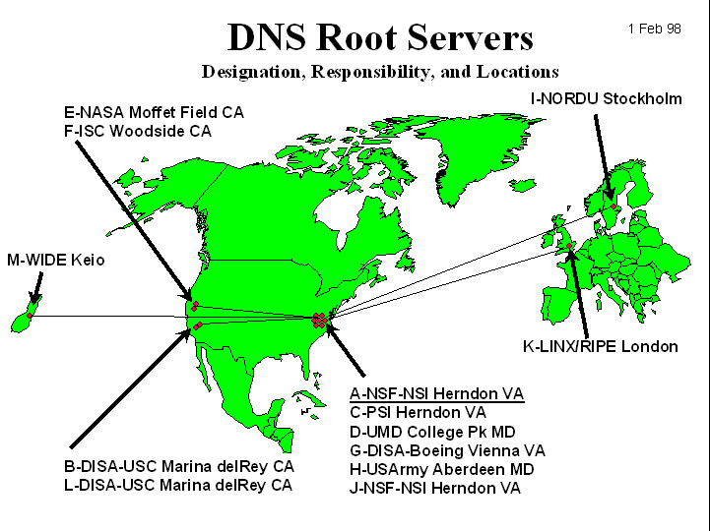
DNS Root Name Servers
Hierarchical service
Root name servers for top-level domains
Authoritative name servers for subdomains
Local name resolvers contact authoritative servers when they do not know a name

Slide 30
DNS Lookup Example
root & edu
DNS server
www.cs.stanford.edu
www.cs.stanford.edu
NS stanford.edu
stanford.edu
DNS server
Local DNS resolver
NS cs.stanford.edu
Client
A www=IPaddr
cs.stanford.edu
DNS server
DNS record types (partial list):
- NS: name server (points to other server)
- A: address record (contains IP address)
- MX: address in charge of handling email
- TXT: generic text (e.g. used to distribute site public keys (DKIM) )

Slide 31
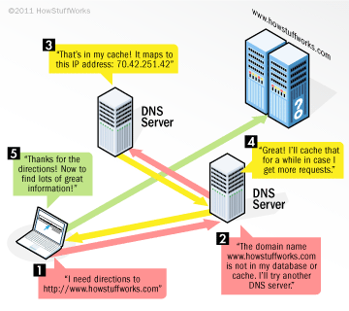
DNS Lookup Example

Slide 32
Caching
DNS responses are cached
Quick response for repeated translations
Useful for finding servers as well as addresses
NS records for domains
DNS negative queries are cached
Save time for nonexistent sites, e.g. misspelling
Cached data periodically times out
Lifetime (TTL) of data controlled by owner of data
TTL passed with every record

Slide 33
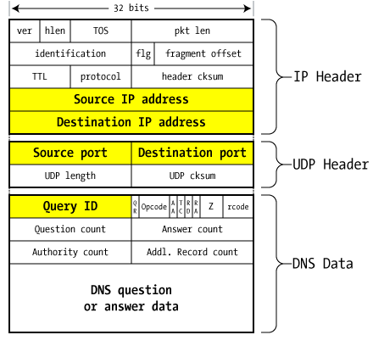
DNS Packet
Query ID:
16 bit random value
Links response to query

Slide 34
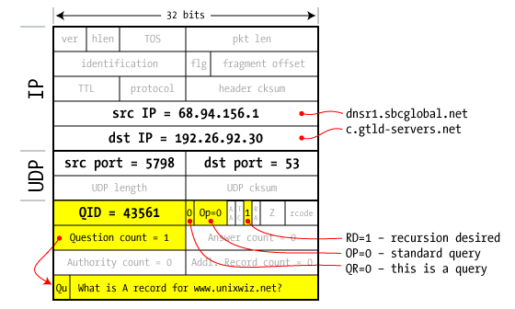
Resolver to NS request

Slide 35
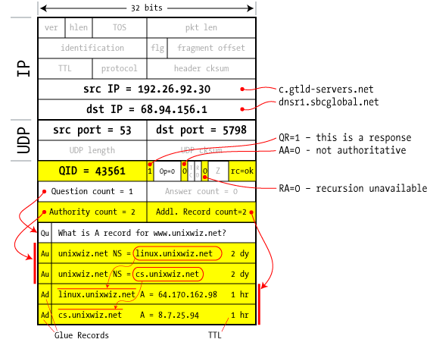
Response to resolver
Response contains IP addr of next NS server
(called “glue”)
Response ignored if unrecognized QueryID

Slide 36
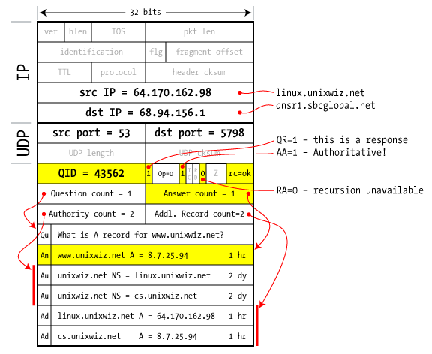
Authoritative response to resolver
bailiwick checking:
response is cached if it is within the same domain of query (i.e. a.com cannot set NS for b.com)
final answer

Slide 37
Basic DNS Vulnerabilities
Users/hosts trust the host-address mapping provided by DNS:
Used as basis for many security policies:
Browser same origin policy (permits scripts running on pages originating from the same site – a combination of scheme, hostname, and port number)
Obvious problems
Interception of requests or compromise of DNS servers can result in incorrect or malicious responses
e.g.: malicious access point in a Cafe
Solution – authenticated requests/responses
Provided by DNSsec … but few use DNSsec
Notes:
Same Origin Policy: The policy permits scripts running on pages originating from the same site – a combination of scheme, hostname, and port number^{[1]} – to access each other's methods and properties with no specific restrictions, but prevents access to most methods and properties across pages on different sites

Slide 38
DNS cache poisoning (a la Kaminsky’08)
Victim machine visits attacker’s web site, downloads Javascript
Query:
a.bank.com
a.bank.com
QID=x₁
user
browser
local
DNS
resolver
ns.bank.com
IPaddr
256 responses:
Random QID y₁, y₂, …
NS bank.com=ns.bank.com
A ns.bank.com=attackerIP
attacker wins if ∃j: x₁ = y_{j}
response is cached and attacker owns bank.com
attacker
Notes:
n July 2008 a new DNS cache-poisoning attack was unveiled that is considered especially dangerous because it does not require substantial bandwidth or processor resources nor does it require sophisticated techniques.
With cache poisoning an attacker attempts to insert a fake address record for an Internet domain into the DNS. If the server accepts the fake record, the cache is poisoned and subsequent requests for the address of the domain are answered with the address of a server controlled by the attacker. For as long as the fake entry is cached by the server (entries usually have a time to live -- or TTL -- of a couple of hours) subscriber's browsers or e-mail servers will automatically go to the address provided by the compromised DNS server.

Slide 39
If at first you don’t succeed …
Victim machine visits attacker’s web site, downloads Javascript
Query:
b.bank.com
b.bank.com
QID=x₂
user
browser
local
DNS
resolver
ns.bank.com
IPaddr
256 responses:
Random QID y₁, y₂, …
NS bank.com=ns.bank.com
A ns.bank.com=attackerIP
attacker wins if ∃j: x₂ = y_{j}
response is cached and attacker owns bank.com
attacker
success after ≈ 256 tries (few minutes)
Notes:
Birthday paradox: success once x_{i} = y_{j} for some i,j .
Success probability after each try is 1/256 ⇒ needs 256 tries on average until success

Slide 40
Defenses
Increase Query ID size. How?
a. Randomize src port, additional 11 bits
Now attack takes several hours
b. Ask every DNS query twice:
Attacker has to guess QueryID correctly twice (32 bits)
Apparently DNS system cannot handle the load

Slide 41
DNS poisoning attacks in the wild
January 2005, the domain name for a large New York ISP, Panix, was hijacked to a site in Australia.
In November 2004, Google and Amazon users were sent to Med Network Inc., an online pharmacy
In March 2003, a group dubbed the "Freedom Cyber Force Militia" hijacked visitors to the Al-Jazeera Web site and presented them with the message "God Bless Our Troops"

Slide 42
DNS Rebinding Attack
<iframe src="http://www.evil.com">
DNS-SEC cannot
stop this attack
Firewall
www.evil.com?
ns.evil.com
DNS server
171.64.7.115 TTL = 0
192.168.0.100
www.evil.com
web server
corporate
web server
171.64.7.115
192.168.0.100
Read permitted: it’s the “same origin”
[DWF’96, R’01]
Notes:
DNS rebinding is a form of computer attack. In this attack, a malicious web page causes visitors to run a client-side script that attacks machines elsewhere on the network. In theory, the same-origin policy prevents this from happening: client-side scripts are only allowed to access content on the same host that served the script. Comparing domain names is an essential part of forcing this policy, so DNS rebinding circumvents this protection by abusing the Domain Name System (DNS).
This attack can be used to breach a private network by causing the victim's web browser to access machines at private IP addresses and returning the results to the attacker. It can also be used to leverage the victim machine for spamming, distributed denial-of-service attacks and other malicious activities.
The attacker registers a domain (such as attacker.com) and delegates it to a DNS server he controls. The server is configured to respond with a very short time to live (TTL) record, preventing the response from being cached. When the victim browses to the malicious domain, the attacker's DNS server first responds with the IP address of a server hosting the malicious client-side code. For instance, he could point the victim's browser to a website that contains malicious JavaScript or Flash.
The malicious client-side code makes additional accesses to the original domain name (such as attacker.com). These are permitted by the same-origin policy. However, when the victim's browser runs the script it makes a new DNS request for the domain, and the attacker replies with a new IP address. For instance, he could reply with an internal IP address or the IP address of a target somewhere else on the Internet.

Slide 43
DNS Rebinding Defenses
Browser mitigation: DNS Pinning
Refuse to switch to a new IP
Interacts poorly with proxies, VPN, dynamic DNS, …
Not consistently implemented in any browser
Server-side defenses
Check Host header for unrecognized domains
Authenticate users with something other than IP
Firewall defenses
External names can’t resolve to internal addresses
Protects browsers inside the organization
Notes:
The following techniques attempt to prevent DNS rebinding attacks:
Web browsers can implement DNS pinning: the IP address is locked to the value received in the first DNS response. This technique may block some legitimate uses of Dynamic DNS, and may not work against all attacks.
Private IP addresses can be filtered out of DNS responses.
External public DNS servers with this filtering e.g. OpenDNS.^{[1]}
Local sysadmins can configure the organization's local nameservers to block the resolution of external names into internal IP addresses.
DNS filtering in a firewall or daemon e.g. dnswall.^{[2]}
Web servers can reject HTTP requests with an unrecognized Host header.
The Firefox NoScript extension provides partial protection (for private networks) using its ABE feature, which blocks web traffic from external addresses to local addresses.

Slide 44
IPSEC

Slide 45
IETF IPSec Working Group
The basic Internet Protocol (IP) has absolutely no security concepts integrated
Data are transferred in plain text
Authentication is not possible, everybody can fake the IP sender address or modify the payload of a packet
Thus: specification of a security architecture for IP that comprises authentication and encryption mechanism
Security mechanisms should be algorithm-independent, cryptographic algorithms can be altered without effecting other parts of the protocol
Wide variety of security policies should be supported
Result:
Compatibility with the Internet structure as given by IPv4 was needed to introduce security functions earlier than the “rest” of IPv6
Thus: in 1992 the IP Security Protocol (IPSec) was standardized, together with theInternet Key Exchange (IKE)

Slide 46
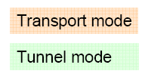
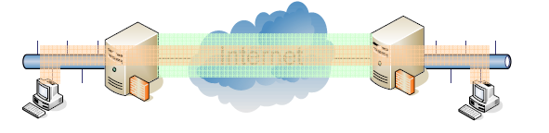
IP Security Protocol (IPSec)
Security design goal: authentication and encryption
Authentication Header (AH): provides sender authentication and data integrity
Encapsulation Security Payload (ESP): provides data encryption
Both mechanism are based on the concept of a security association (SA) and may be used together or separately
Work modes:
Transport mode
Build a point-to-point connection between two hosts
Tunnel mode
Connect two “security gateways”, i.e. whole networks. Security gateways can be integrated with the access routers of the networks

Slide 47
Security Associations (SA)
A security association is an agreement between two or more parties regarding security services that they want to use and how they are going to provide them
This agreement is established through a common set of security related parameters like
Authentication algorithm, mode and keys for the AH
Encryption algorithm, mode, and keys for the ESP
An initialization vector (IV), if necessary
Lifetime of the keys and the SA as a whole
Source address
Security level of the protected data, such as confidential, secret or unclassified
When an IP packet is received, it can only be authenticated and/or decrypted if the receiver can link it with an appropriate SA. Hence the IP packet must convey a reference that points to the SA on the receiver's side
In IPSec this reference is called a security parameter index (SPI)
Each SA is uniquely identified by a destination address and a SPI value negotiated before communication by the Internet Key Exchange (IKE) protocol

Slide 48
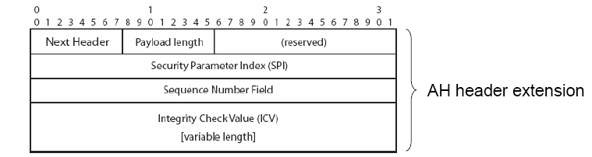
Authentication Header (AH)
AH provides sender authentication and data integrity for IP packets by enhancing the IP header with some additional fields:
Next Header: type of the following header after the AH (as the protocol field in IPv4)
Payload Length: length of the integrity check value (ICV) in 32-bit words
Reserved: for future use, currently set to zero
SPI: identifies the SA for the IP packet on receiver side
Sequence number: assign each packet an unique identifier to protect against replay attacks
ICV: the assigned authentication/integrity value

Slide 49
Integrity Check Value
The authentication data mostly is computed by using a cryptographic authentication algorithm and a corresponding secret key
Use a one-way hash function, MD5 is default in IPSec
The ICV in case of MD 5 is a 128-bit hash value from the concatenation of the key, the message, and the key again
Alternative: use digital signatures from public key cryptography
In general, the authentication algorithm is negotiated as part of the SA
The receiver uses the same algorithm to test the ICV
Problem: some fields of the IP packet header change in transit, e.g. the TTL field in IPv4
The ICV is computed for a whole IP packet
With another TTL, the receiver comes to another ICV as the sender
Thus, the receiver has to set such information like TTL back to the initial value before computing and testing the ICV value
Note: AH does not encrypt the payload!

Slide 50
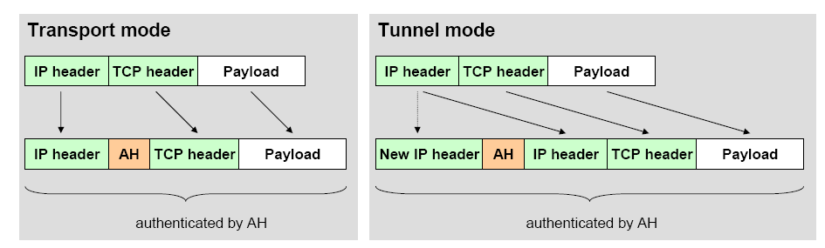
Use of the Authentication Header
AH can be used in two ways:
In general, AH has the following characteristics
Advantage: AH mechanism does not significantly increase implementation costs
Disadvantage: AH increases IP processing costs and communication latency in participating systems

Slide 51
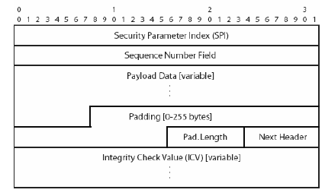
Encapsulating Security Payload (ESP)
ESP provides data confidentiality by using encryption and encapsulation and adding an ESP header/trailer to an IP packet:
SPI, Sequence Number, and ICV (only if integrity is also checked): as in AH
Payload data: encrypted with an algorithm defined in the SA (default: DES in CBC mode)
Padding: filled with random bits
Padding Length: indicates the total length of the Padding field
Next header: identifies the following header

Slide 52
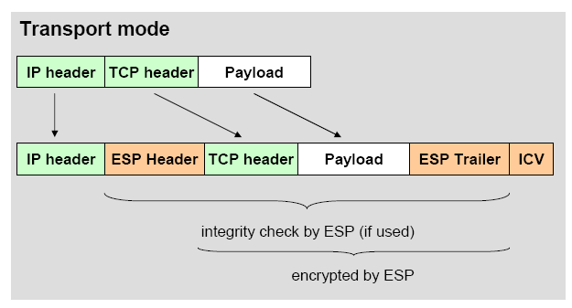
Use of the Encapsulating Security Payload
ESP can be used in two ways, as AH:
The receiver processes the IP header and plaintext part of the ESP to obtain the SPI value
This value is used as an index for a local SPI table to find the negotiated SA parameters and cryptographic keys to decrypt the rest of the packet

Slide 53
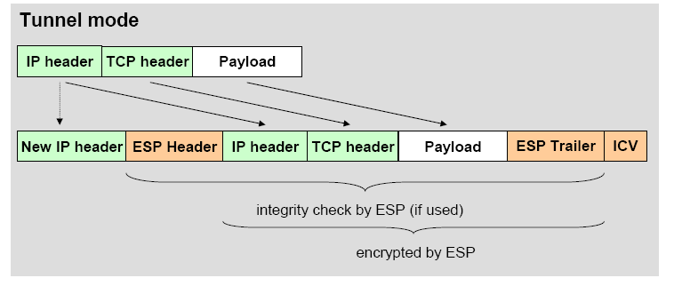
Use of the Encapsulating Security Payload
In tunnel mode, an encrypted tunnel between two security gateways is installed
Used e.g. between two LANs which should communicate in a secure manner (as in VPN, Virtual private Network)
Note: AH and ESP mechanism have been designed independently and can be applied separately or together

Slide 54
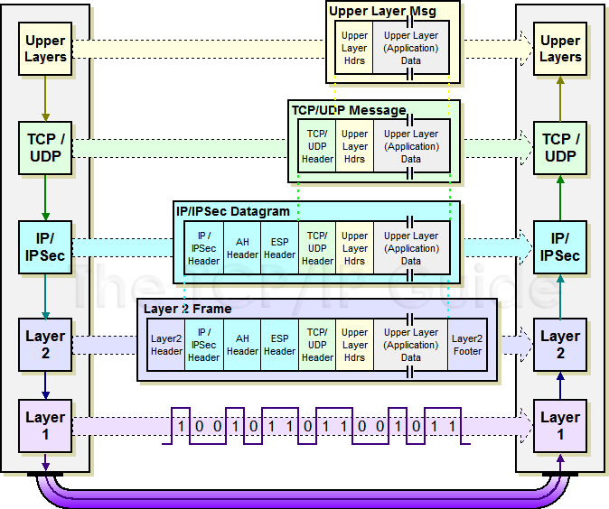
IPSec Transport Mode: IPSEC instead of IP header
http://www.tcpipguide.com/free/t_IPSecModesTransportandTunnel.htm

Slide 55
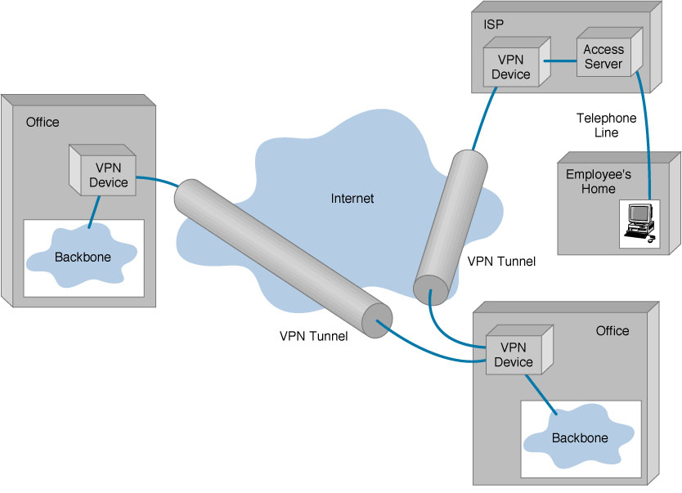
IPSEC Tunnel Mode

Slide 56
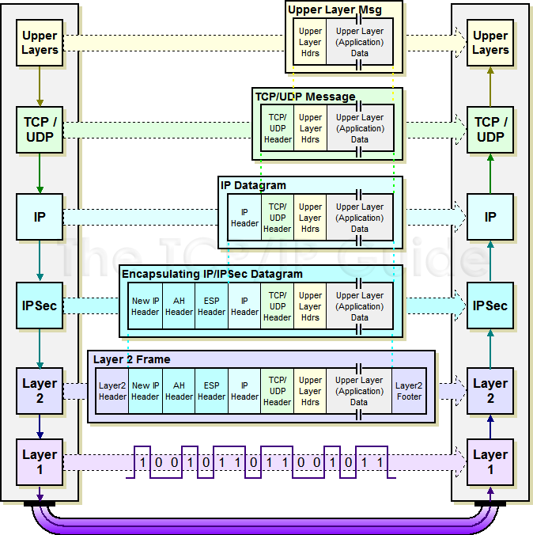
IPSec Tunnel Mode: IPSEC header + IP header

Slide 57
Internet Key Exchange (IKE)
Before applying AH and/or ESP, a SA has to be established – this is done using the
Internet Key Exchange (IKEv2) in two phases:
Phase 1: negotiate a SA in two steps
Purpose: mutual authentication, establish secret keys for phase 2
Phase 2: create multiple SAs used for one communication each
Purpose: from the results of phase 1, several SAs can be generated, which gives a speedup (if several SAs are needed)

Slide 58
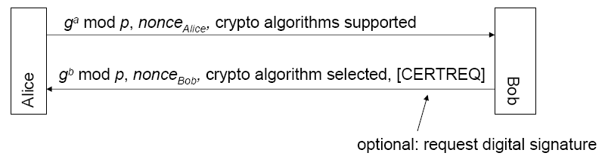
IKE Phases
First half of phase 1: establish a common secret using Diffie-Hellman key exchange:
Second half of phase 1: mutual authentication
Using the key negotiated by Diffie-Hellman, now encrypted mutual authentication is done – optionally by using certificates, if requested before
In the authentication messages, also IP addresses and TCP ports of communication partners are included
IKE phase 2: applied after mutual authentication.
Use negotiated key to propose/accept SAs – maybe also by doing a new key exchange with every SA proposal to generate new session keys

Slide 59
Virtual Private Networks (VPN)

Slide 60
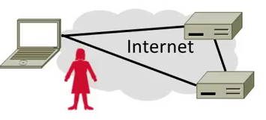
Topic
Virtual Private Networks (VPNs)
Run as closed (private) networks on Internet
Use IPSEC to secure messages

Slide 61
Motivation
The best part of IP connectivity
You can send to any other host
The worst part of IP connectivity
Any host can send packets to you!
There’s nasty stuff out there …

Slide 62
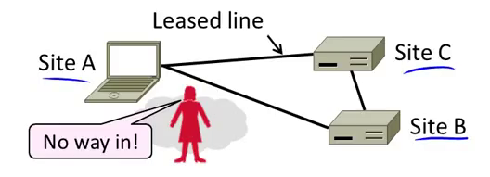
Motivation (2)
Often desirable to separate network from the Internet, e.g., a company
Private network with leased lines
Physically separated from Internet

Slide 63
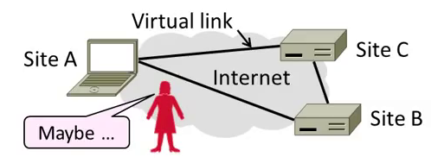
Motivation (3)
Idea: Use the public Internet instead of leased lines – cheaper!
Logically separated from Internet …
This is a Virtual Private Network (VPN)

Slide 64
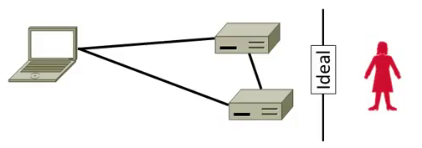
Goal and Threat Model
Goal is to keep a logical network (VPN) separate from the Internet while using it for connectivity
Threat is EVE may access VPN and intercept or tamper with messages

Slide 65
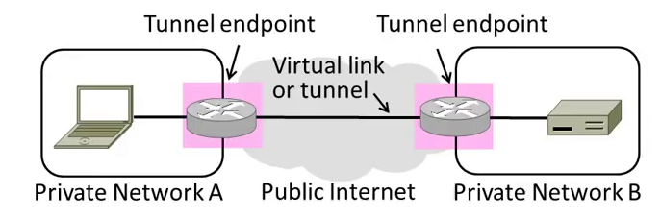
Tunneling
How can we build a virtual link? With tunneling!
Hosts in private network send to each other normally
To cross virtual link (tunnel), endpoints encapsulate packet

Slide 66
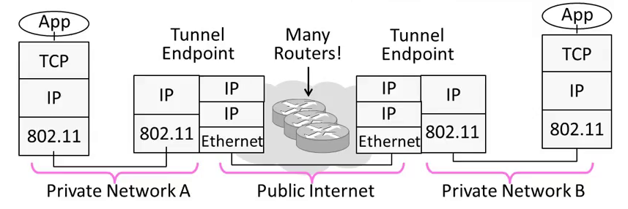
Tunneling (2)
Tunnel endpoints encapsulate IP packets (“IP in IP”)
Add/modify outer IP header for delivery to remote endpoint

Slide 67
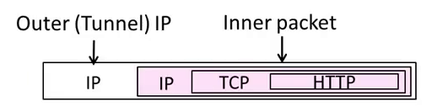
Tunneling (3)
Simplest encapsulation wraps packet with another IP header
Outer (tunnel) IP header has tunnel endpoints as source/destination
Inner packet has private network IP addresses as source/destination

Slide 68
Tunneling (4)
Tunneling alone is not secure …
No confidentiality, integrity/ authenticity
EVE can read, inject her own messages
We require cryptographic protections!
IPSEC (IP Security) is often used to secure VPN tunnels

Slide 69
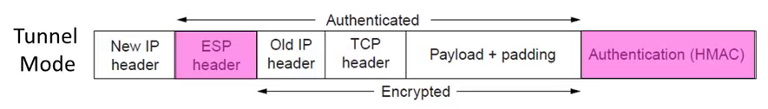
IPSEC (IP Security)
Longstanding effort to secure the IP layer
Adds confidentiality, integrity/authenticity
IPSEC operation:
Keys are set up for communicating host pairs
Communication becomes more connection-oriented
Header and trailer added to protect IP packets

Slide 70
Summary
VPNs are useful for building networks on top of the Internet
Virtual links encapsulate packets
Alters IP connectivity for hosts
VPNs need crypto to secure messages
Typically IPSEC is used for confidentiality, integrity/authenticity

Slide 71
Summary (2)
Three different modes of use:
Remote access client connections
LAN-to-LAN internetworking
Controlled access within an intranet
Several different protocols
PPTP – Point-to-point tunneling protocol
L2TP – Layer-2 tunneling protocol
IPsec (Layer-3: network layer)
Data layer

Slide 72
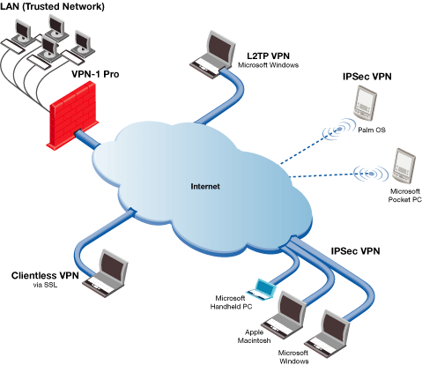
Credit: Checkpoint

Slide 73
Firewall

Slide 74
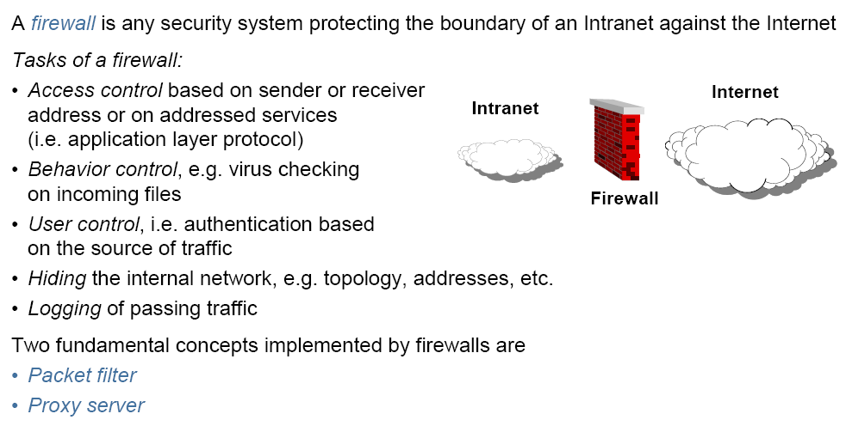
Firewall

Slide 75
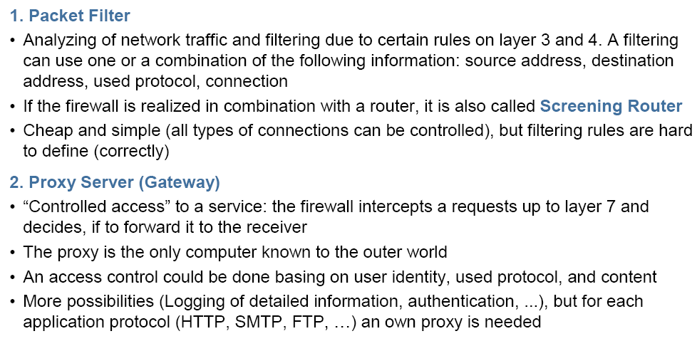
Types of Firewalls
Notes:
Firewall can also be a software at your PC. In Linux you can also define rules on IP Tables.

Slide 76
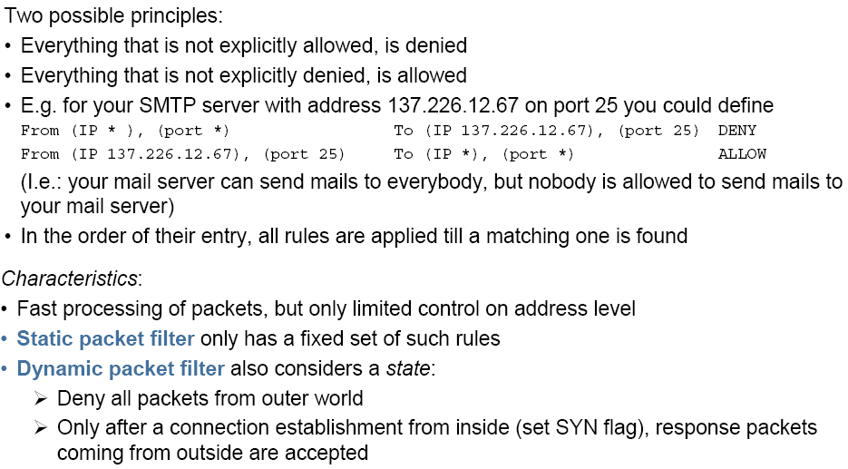
Packet Filter
Notes:
In computing, a stateful firewall (any firewall that performs stateful packet inspection (SPI) or stateful inspection) is a firewall that keeps track of the state of network connections (such as TCP streams,UDP communication) traveling across it. The firewall is programmed to distinguish legitimate packets for different types of connections. Only packets matching a known active connection will be allowed by the firewall; others will be rejected.

Slide 77
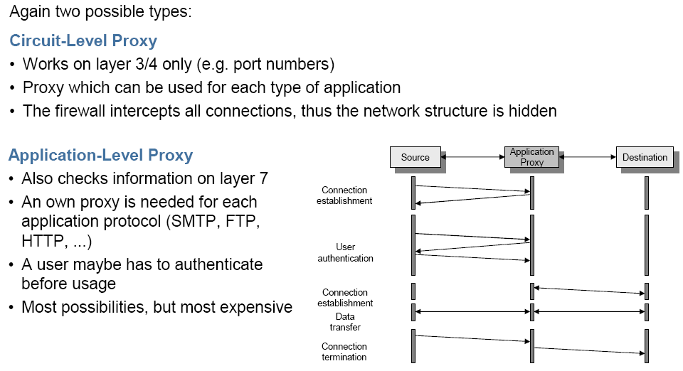
Proxy Server

Slide 78
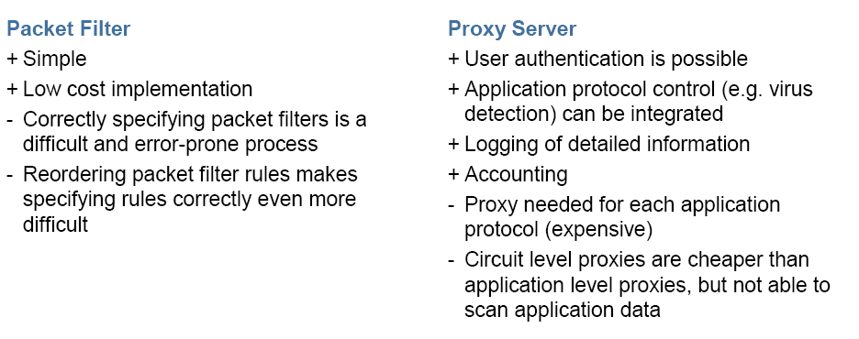
Packet Filter vs Proxy Server

Slide 79
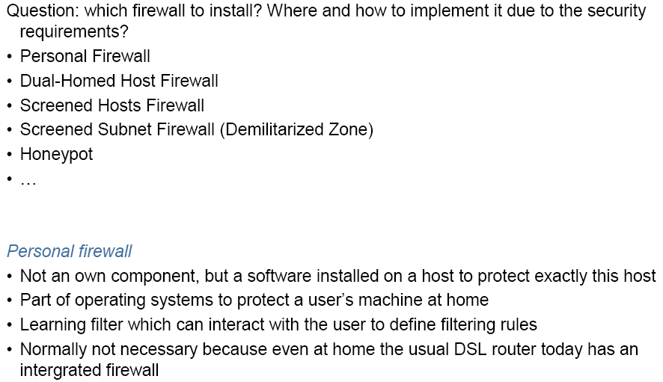
Security Architectures

Slide 80
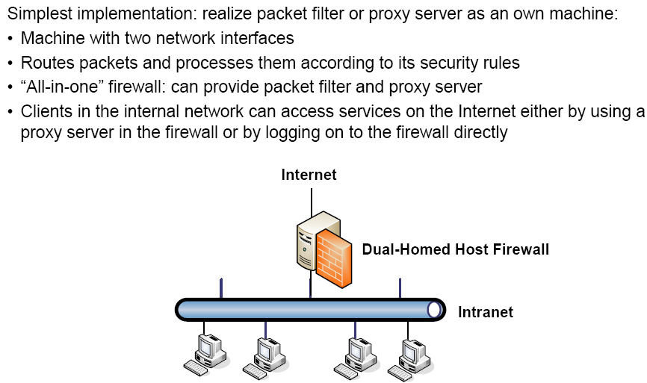
Dual-Homed Host Firewall
Notes:
A dual-homed host (or dual-homed gateway^{[1]}) is a system fitted with two network interfaces (NICs) that sits between an untrusted network (like the Internet) and trusted network (such as a corporate network) to provide secure access. Dual-homed is a general term for proxies, gateways, firewalls, or any server that provides secured applications or services directly to an untrusted network.

Slide 81
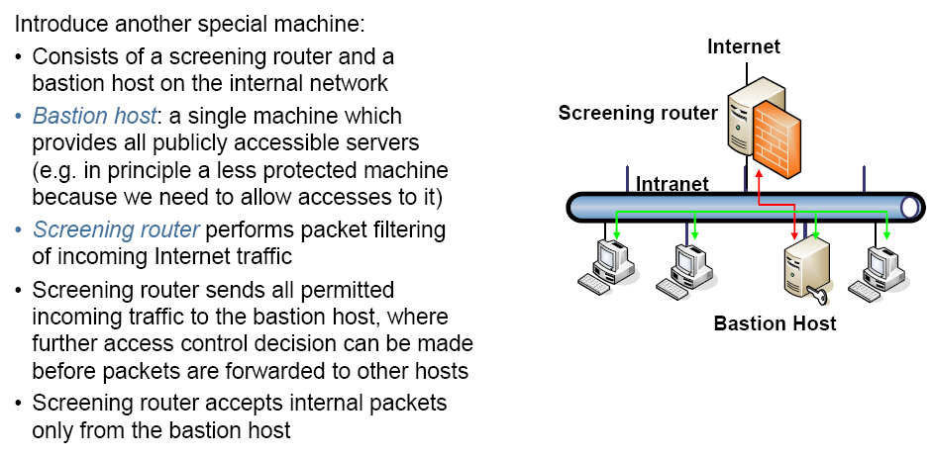
Screened Hosts Firewall

Slide 82
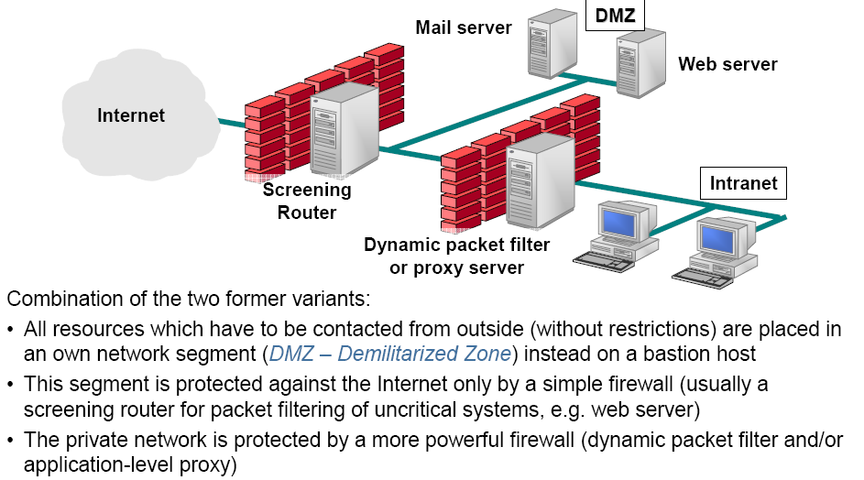
Demilitarized Zone

Slide 83
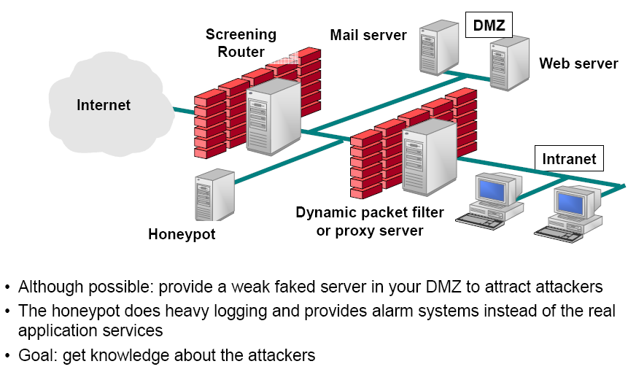
Additional: Honeypot

Slide 84
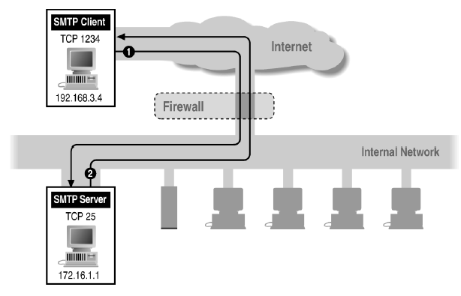
Filtering Example: Inbound SMTP
Can block external request to internal server based on port number

Slide 85
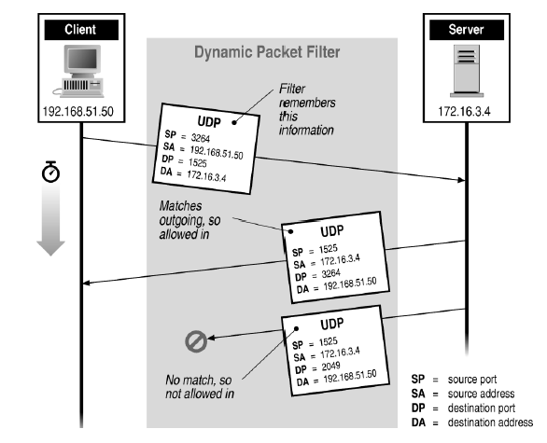
Stateful or Dynamic Packet Filtering

Slide 86


Firewall references
Elizabeth D. Zwicky
Simon Cooper
D. Brent Chapman
William R Cheswick
Steven M Bellovin
Aviel D Rubin

Slide 87
Intrusion Detection

Slide 88
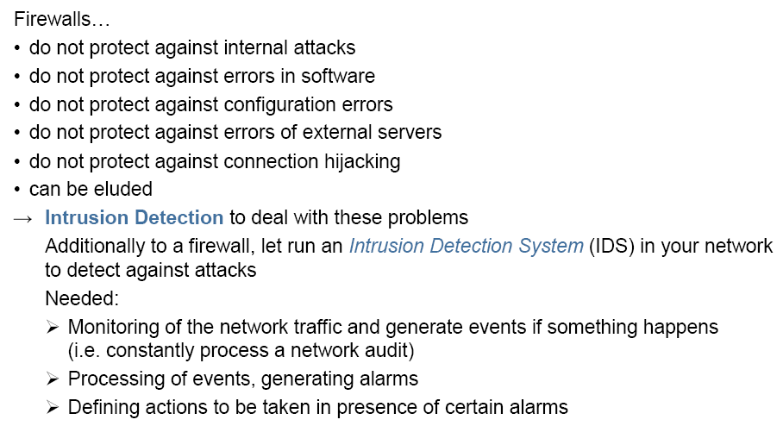
Intrusion Detection

Slide 89
Intrusion detection
Many intrusion detection systems
Close to 100 systems with current web pages
Network-based, host-based, or combination
Two basic models
Misuse detection model
Maintain data on known attacks
Look for activity with corresponding signatures
Anomaly detection model
Try to figure out what is “normal”
Report anomalous behavior
Fundamental problem: too many false alarms

Slide 90
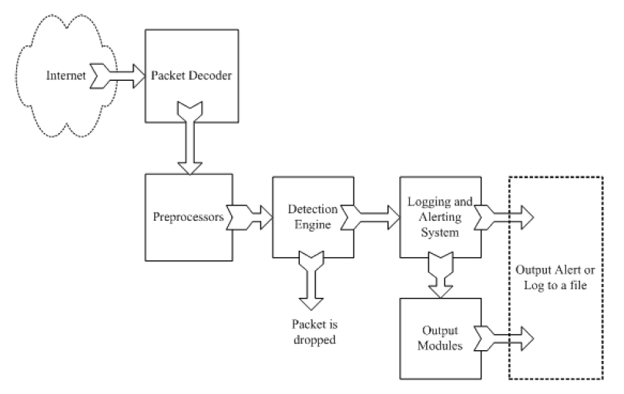
Example: Snort
http://www.snort.org/
From: Rafeeq Ur Rehman, Intrusion Detection Systems with Snort: Advanced IDS Techniques with Snort, Apache, MySQL, PHP, and ACID.

Slide 91
Snort components
Packet Decoder
input from Ethernet, SLIP, PPP…
Preprocessor:
detect anomalies in packet headers
packet defragmentation
decode HTTP URI
reassemble TCP streams
Detection Engine: applies rules to packets
Logging and Alerting System
Output Modules: alerts, log, other output

Slide 92
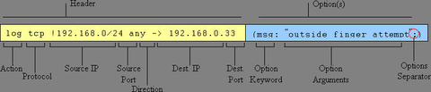
Snort detection rules
rule header
rule options

Slide 93

Additional examples
destination ip address
Apply to all ip packets
Destination port
Source ip address
Source port #
Rule options
Alert will be generated if criteria met

Slide 94
Snort challenges
Misuse detection – avoid known intrusions
Database size continues to grow
Snort version 2.3.2 had 2,600 rules
Snort spends 80% of time doing string match
Anomaly detection – identify new attacks
Probability of detection is low

Slide 95
Difficulties in anomaly detection
Lack of training data
Lots of “normal” network, system call data
Little data containing realistic attacks, anomalies
Data drift
Statistical methods detect changes in behavior
Attacker can attack gradually and incrementally
Main characteristics not well understood
By many measures, attack may be within bounds of “normal” range of activities
False identifications are very costly
Sys Admin spend many hours examining evidence

Slide 96
DNSSEC

Slide 97
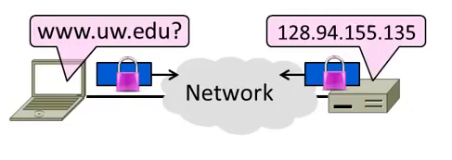
Topic
Securing Internet naming
DNS security extensions (DNSSEC)

Slide 98
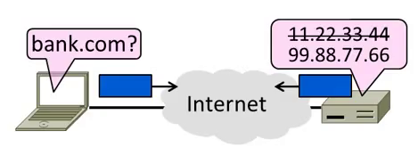
Goal and Threat Model
Naming is a crucial Internet service
Binds host name to IP address
Wrong binding can be disastrous …

Slide 99
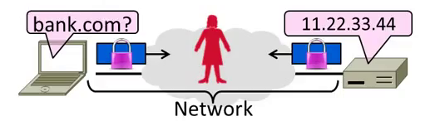
Goal and Threat Model (2)
Goal is to secure the DNS so that the returned binding is correct
Integrity/authenticity vs confidentiality
Attacker (Trudy) can intercept/tamper with messages on the network
Notes:
It is about integrity and Authenticity and not about confidentiality

Slide 100
DNS Spoofing
Hang on – how can a network attacker corrupt the DNS?
Trudy can trick a nameserver into caching the wrong binding
By using the DNS protocol itself
This is called DNS spoofing

Slide 101
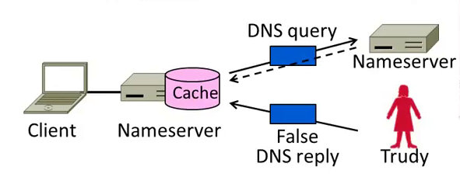
DNS Spoofing (2)
To spoof, Trudy returns a fake DNS response that appears to be true
Fake response contains bad binding

Slide 102
DNS Spoofing (3)
Lots of questions!
1. How does Trudy know when the DNS query is sent and what it is for?
2. How can Trudy supply a fake DNS reply that appears to be real?
3. What happens when the real DNS reply shows up?
There are solutions to each issue …

Slide 103
DNS Spoofing (4)
1. How does Trudy know when the query is sent and what it is for?
Trudy can make the query herself!
Nameserver works for many clients
Trudy is just another client
Notes:
Nameserver is a device that work on behalf of a pool of local clients. Trudy can really can act as one of those local clients. Often Nameserver don’t have access restrictions.

Slide 104
DNS Spoofing (5)
2. How can Trudy supply a fake DNS reply that appears to be real?
A bit more difficult. DNS checks:
Reply is from authoritative nameserver (e.g., .com)
Reply ID that matches the request
Reply is for outstanding query
• (Nothing about content though …)

Slide 105
DNS Spoofing (6)
2. How can Trudy supply a fake DNS reply that appears to be real?
Techniques:
Put IP of authoritative nameserver as the source IP address
ID is 16 bits (64K). Send many guesses! (Or if a counter, sample to predict.)
Send reply right after query
Good chance of succeeding!
Notes:
Normally network doesn’t check the source IP, so we can fake the IP

Slide 106
DNS Spoofing (7)
3. What happens when the real DNS reply shows up?
Likely not be a problem
There is no outstanding query after fake reply is accepted
So real reply will be discarded

Slide 107
DNSSEC (DNS Security Extensions)
Extends DNS with new record types
RRSIG for digital signatures of records
DNSKEY for public keys for validation
DS for public keys for delegation
First version in ‘97, revised by ’05
Deployment requires software upgrade at both client and server
Root servers upgraded in 2010
Followed by uptick in deployment

Slide 108
DNSSEC (2) – New Records
As well as the usual A, NS records
RRSIG
Digital signatures of domain records
DNSKEY
Public key used for domain RRSIGs (for validation of signatures)
DS
Public keys for delegated domain
NSEC/NSEC3
Authenticated denial of existence (answer from an authoritative NS that really there is no domain)
Notes:
A = ip Address
NS = Name Server
RRSIG = To check that the information in the record was correct
DS = Delegation Server record is used by one NameServer to tell you the PK of another NameServer.

Slide 109
DNSSEC (3) – Validating Replies
Clients query DNS as usual, then validate replies to check that content is authentic
Trust anchor is root public keys
Part of DNS client configuration
Trust proceeds down DNS hierarchy
Similar concept to SSL certificates

Slide 110
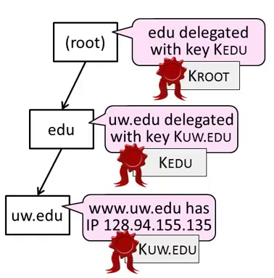
DNSSEC (4) – Validating Replies
Client queries www.uw.edu as usual
Replies include signatures/keys
Client validates answer:
1. KROOT is a trust anchor
2. Use KROOT to check KEDU
3. Use KEDU to check KUW.EDU
4. Use KUW.EDU to check IP

Slide 111
DNSSEC (5)
Other features too:
Authoritative answers a domain record doesn’t exist (NSEC/NSEC3)
Optional anti-spoofing to bind query and reply
Flags related to deployment …

Slide 112
Summary
DNS spoofing is possible without added security measures
Large problem in practice!
DNSSEC adds authentication (only) of replies to the DNS
Using a hierarchy of public keys

Slide 113
DDoS

Slide 114
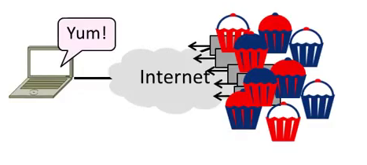
Topic
Distributed Denial-of-Service (DDOS)
An attack on network availability
Notes:
Very different kind of security problem. Confidentiality, Authentication don’t works

Slide 115
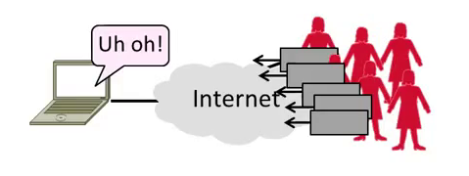
Topic
Distributed Denial-of-Service (DDOS)
An attack on network availability

Slide 116
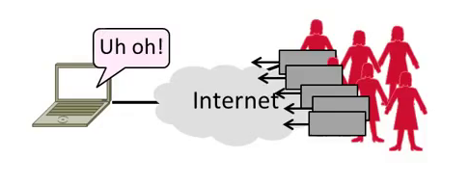
Motivation
The best part of IP connectivity
You can send to any other host
The worst part of IP connectivity
Any host can send packets to you!

Slide 117

Motivation (2)
Flooding a host with many packets can interfere with its IP connectivity
Host may become unresponsive
This is a form of denial-of-service
Notes:
Because all the resource in the network are consumed

Slide 118

Goal and Threat Model
Goal is for host to keep network connectivity for desired services
Threat is Trudy may overwhelm host with undesired traffic

Slide 119
Internet Reality
Distributed Denial-of-Service is a huge problem today!
Akamai Q3-12 reports DDOS against US banks peaking at 65 Gbps of traffic flooding the bank
There are no great solutions
CDNs, network traffic filtering, and best practices all help
Notes:
Akamai which monitors the state of the internet.

Slide 120
Denial-of-Service
Denial-of-service means a system is made unavailable to intended users
Typically because its resources are consumed by attackers instead
In the network context:
“System” means server
“Resources” mean bandwidth (network) or CPU/memory (host)

Slide 121

Host Denial-of-Service
Strange packets can sap host resources!
“Ping of Death” malformed packet (bug the kernel and system crash)
“SYN flood” sends many TCP connect requests and never follows up
Few bad packets can overwhelm host
Patches exist for these vulnerabilities
Read about “SYN cookies” for interest
Notes:
You can send a ping packet and it is formed in such a way that it will create a kernel bug and crash the system.
SYN Flood used to work in the old days.
Patches for ping of death are also available. SYN Cookies are a defense of SYN Flood.

Slide 122

Network Denial-of-Service
Network DOS needs many packets
To saturate network links
Causes high congestion/loss
Helpful to have many attackers or Distributed Denial-of-Service
Notes:
Simply send enough network to saturate the network

Slide 123

Distributed Denial-of-Service (DDoS)
Botnet provides many attackers in the form of compromised hosts
Hosts send traffic flood to victim
Network saturates near victim
Notes:
Access link for the victim will be saturated.
On top of that the attacker will also spoof the IP source address

Slide 124

Complication: Spoofing
Attackers can falsify their IP address
Put fake source address on packets
Historically network doesn’t check
Hides location of the attackers
Called IP address spoofing

Slide 125

Spoofing (2)
Actually, it’s worse than that
Trudy can trick Bob into really sending packets to Alice
To do so, Trudy spoofs Alice to Bob

Slide 126

Best Practice: Ingress Filtering
Idea: Validate the IP source address of packets at ISP boundary (Duh!)
Ingress filtering is a best practice, but deployment has been slow
Notes:
We can stop most of these attacks

Slide 127
Flooding Defenses
1. Increase network capacity around the server; harder to cause loss
Use a CDN for high peak capacity
2. Filter out attack traffic within the network (at routers)
The earlier the filtering, the better
Ultimately what is needed, but ad hoc measures by ISPs today
Notes:
CDN is simply distributing the Content server at multiple location so you will get higher bandwidth at multiple locations

Slide 128
Acknowledgements
Material in this lecture are taken from the slides prepared by:
Prof. Dan Boneh (Standford)
Prof. O. Spaniol (RWTH Aachen)
Prof. David Wetheral (University of Washington)

